Slide 1
The “WHY?” Question

Slide 2
Data Visualization
Present the data
Understand the data
Criticize the presentation
It all comes down to data and how we interpret the data
It is crucial to always ask “Why?”
Statistics is the art of lying with numbers

Slide 3
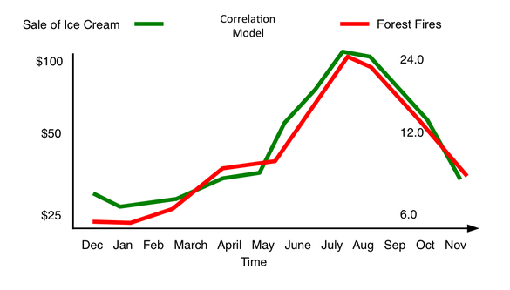
Correlation
Why would ice cream sales affect forest fires?

Slide 4
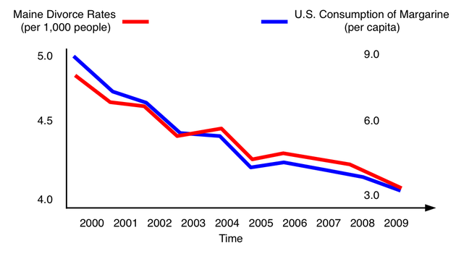
Big data
Why would marine divorce rates be related to margarine consumption?

Slide 5
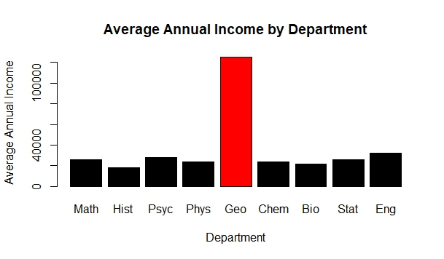
Reporting Mean
Why would geology majors make so much more than others?

Slide 6
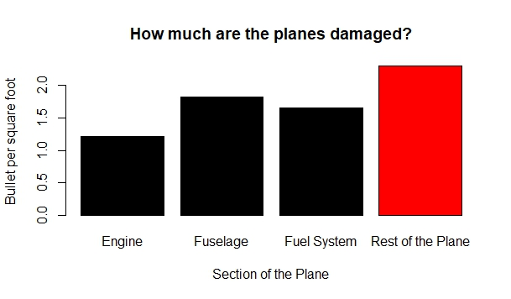
Bias
Why do certain body parts get hit more than others?

Slide 7
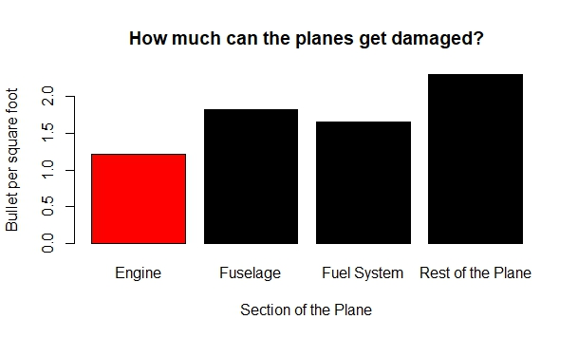
Bias

