Slide 1
Data visualization as a mind extension technology
Rotem Petranker, March 30th

Slide 2
Introduction
The Extended Mind hypothesis
Data visualization as a mind expansion technology
Data visualization: past and present
Data of the future and its challenges
Data visualization in the future
The impact of future data visualization on science
Summary

Slide 3
The extended mind hypothesis
Notes:
The mind exists outside the confines of the skull. by Andy Clark and David Chalmers (1998)^{[1]} is a seminal work in the field of extended cognition. In this paper, Clark and Chalmers present the idea of active externalism (similar to semantic or "content" externalism), in which objects within the environment function as a part of the mind. They argue that it is arbitrary to say that the mind is contained only within the boundaries of the skull. The separation between the mind, the body, and the environment is seen as an unprincipled distinction. Because external objects play a significant role in aiding cognitive processes, the mind and the environment act as a "coupled system". This coupled system can be seen as a complete cognitive system of its own. In this manner, the mind is extended into the external world. The main criterion that Clark and Chalmers list for classifying the use of external objects during cognitive tasks as a part of an extended cognitive system is that the external objects must function with the same purpose as the internal processes.
In "The Extended Mind", a thought experiment is presented to further illustrate the environment's role in connection to the mind. The fictional characters Otto and Inga are both travelling to a museum simultaneously. Otto has Alzheimer's disease, and has written all of his directions down in a notebook to serve the function of his memory. Inga is able to recall the internal directions within her memory. In a traditional sense, Inga can be thought to have had a belief as to the location of the museum before consulting her memory. In the same manner, Otto can be said to have held a belief of the location of the museum before consulting his notebook. The argument is that the only difference existing in these two cases is that Inga's memory is being internally processed by the brain, while Otto's memory is being served by the notebook. In other words, Otto's mind has been extended to include the notebook as the source of his memory. The notebook qualifies as such because it is constantly and immediately accessible to Otto, and it is automatically endorsed by him.
Going further, the authors ask and answer their own question about the role of enculturation:
"And what about socially-extended cognition? Could my mental states be partly constituted by the states of other thinkers? We see no reason why not, in principle."They bring up the recurrent theme of the role of language:
"The major burden of the coupling between agents is carried by language ... Indeed, it is not implausible that the explosion of intellectual development in recent evolutionary time is due as much to this linguistically-enabled extension of cognition as to any independent development in our inner cognitive resources."

Slide 4
Which Car Has a Good MPG to Weight Ratio?

Slide 5
Which Car Has a Good MPG to Weight Ratio?

Slide 6
On the Origin of the Species

Slide 7
Mammalian Family Tree
Notes:
Ernst Haeckel
Family tree of mammals
From Generelle Morphologie der
Organismen
1866

Slide 8
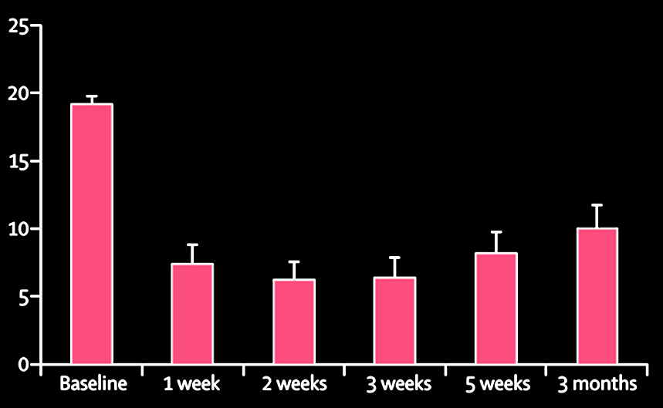
Bar graphs
Quick Inventory of Depressive Symptomatology (QIDS) Scores
(Carhart-Harris et al., 2017)
Notes:
The Effects of Psilocybin on Depression

Slide 9
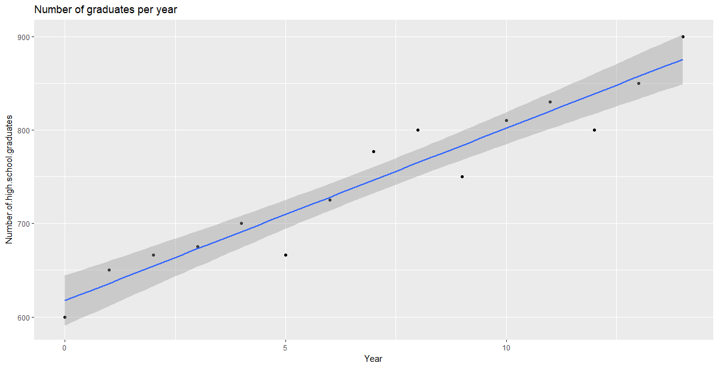
Regression lines
Notes:
Lots of anecdotal claims have been made about microdosing psychedelics but no research has been published and no controlled studies have been run: it is hard to say how real and replicable these effects are, whether or not they apply to all populations, and how they operate. These questions require rigorous scientific study.

Slide 10
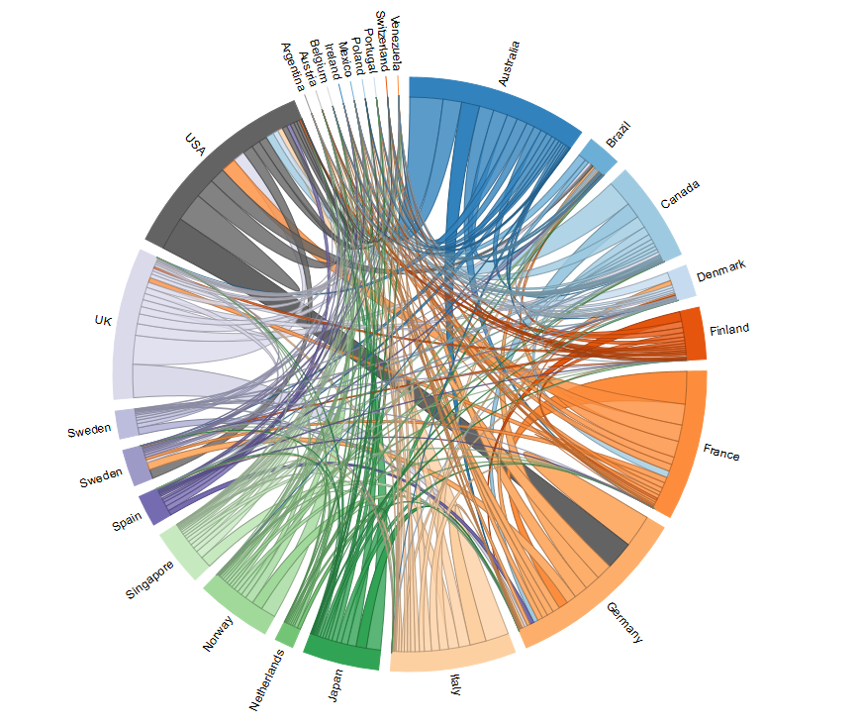
Chord diagram
Notes:
Quantity by costumer/provider country

Slide 11
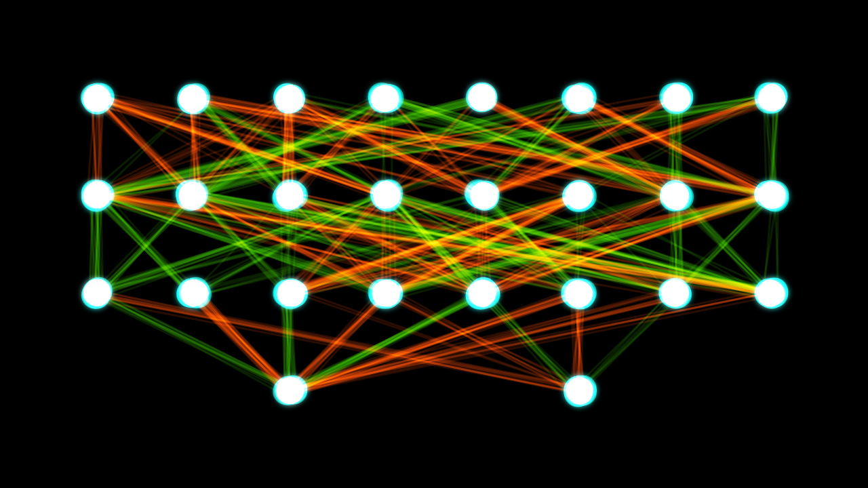
What if there is too much information?
Notes:
Magic number seven, plus minus two

Slide 12
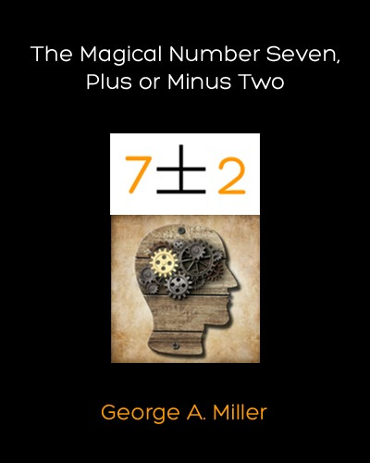
The limits of unassisted cognition

Slide 13
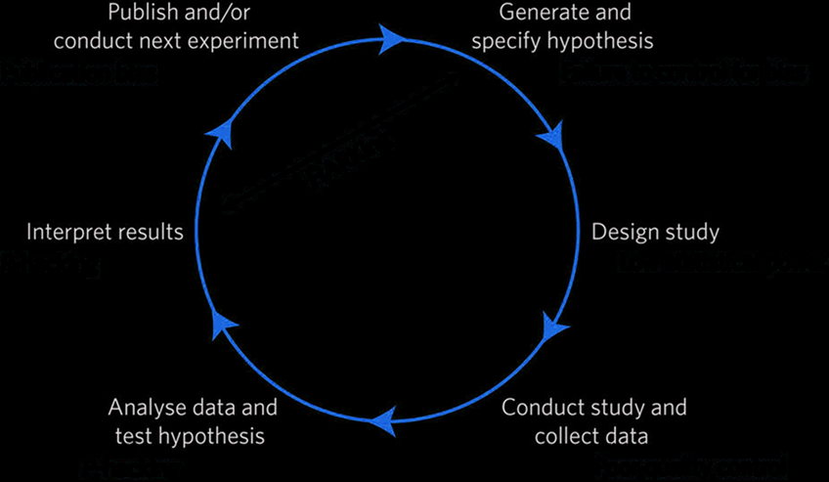
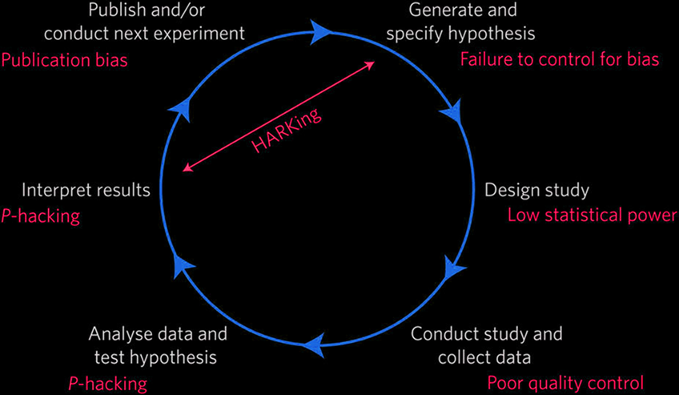
Current science
(Munafò et al., 2017)
Notes:
Good science needs to be reproducible and should be replicable, that is, if we run the same experiment under the same conditions we should get the same results.
The best way to make replicable science is to pre-register your study.
A pre-registration is basically writing down what you are going to do before you do it, and then doing what you said you'd do.
<explain diagram>: you generate a hypothesis, then design and run a study, collect and analyze the data, the interpret and write up your results, which become the basis of new hypotheses.
The problem is that people didn't do that, but that was bad science, or not really science at all. This led to the replicability crisis wherein less than 40% of psychology studies successfully replicated.
I’ll say that again in a different way: more than half of the “findings” in psychology could not be found when they were tested again.
So what happened? Well, people didn’t control for their biases, then ran studies with too few participants leading to underpowered studies with poor quality control, they “p-hacked” i.e. they re-ran different statistics until they "found" something at p<0.05, then they tried to get their papers published by writing papers *as if* they had planned to look for what they eventually “found”. This is called HARKing “Hypothesizing After the Results are Known”.
That's not the right way to do science or to use statistics. When people try to use those results, most of them are not "real“. That’s not how we want to do our science.
HARKing (Hypothesizing After the Results are Known). HARKing is defined as presenting a post hoc hypothesis in one's research report as if it were an a priori hypotheses.

Slide 14
How can AI create novel visualizations?

Slide 15
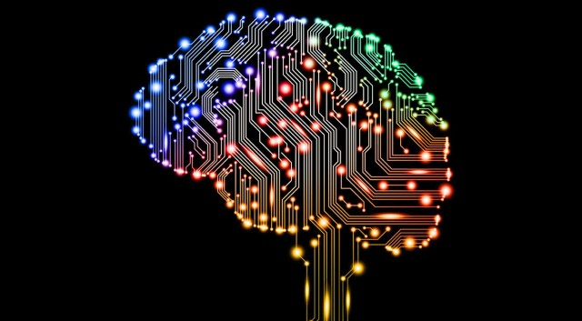
Future science
(Munafò et al., 2017)

Slide 16
Summary
Data visualization is an invaluable scientific tool
The increasing plethora of data can be managed using intelligent visualization
The future of data visualization remains bright

