Slide 1
MV Stats News
Vol. 4, Number 1, February 2, 2017
Bringing multivariate data analysis and data visualization to your breakfast table
Today’s topic:
Low Socioeconomic Status Affects Life Expectancy More Than Obesity
Michael Friendly, Staff Reporter
Filed: 2/2/2017 9:47 AM
From: Socioeconomic status and the 25 × 25 risk factors as determinants of premature mortality: a multicohort study and meta-analysis of 1·7 million men and women. The Lancet, DOI: 10.1016/S0140-6736(16)32380-7

Slide 2
Summary
Over 40 long term cohort studies (total N>1.7M) were analyzed for risk factors of premature mortality
Each study used a form of survival analysis to estimate “hazard ratios” corresponding to various risk factors: smoking, diabetes, being inactive, … and now, SES (defined: High/Low by occupational group)
Results were combined in a meta analysis to estimate pooled HR and “years lost of life” (YLL)
Low SES is an important contributor to premature death

Slide 3
Results
Risk factor | Estimated years lost
Current smoking | 4.8
Diabetes | 2.9
Being inactive | 2.4
Low SES | 2.1
High blood pressure | 1.6
Obesity | 0.7
High alcohol | 0.5

Slide 4
Methods
Survival analysis
Essentially a regression analysis to estimate the “hazard rate” of various predictors
In the study, they used “semi-parametric” models with cubic splines to allow for non-linear effects
deaths/# at risk per unit time

Slide 5
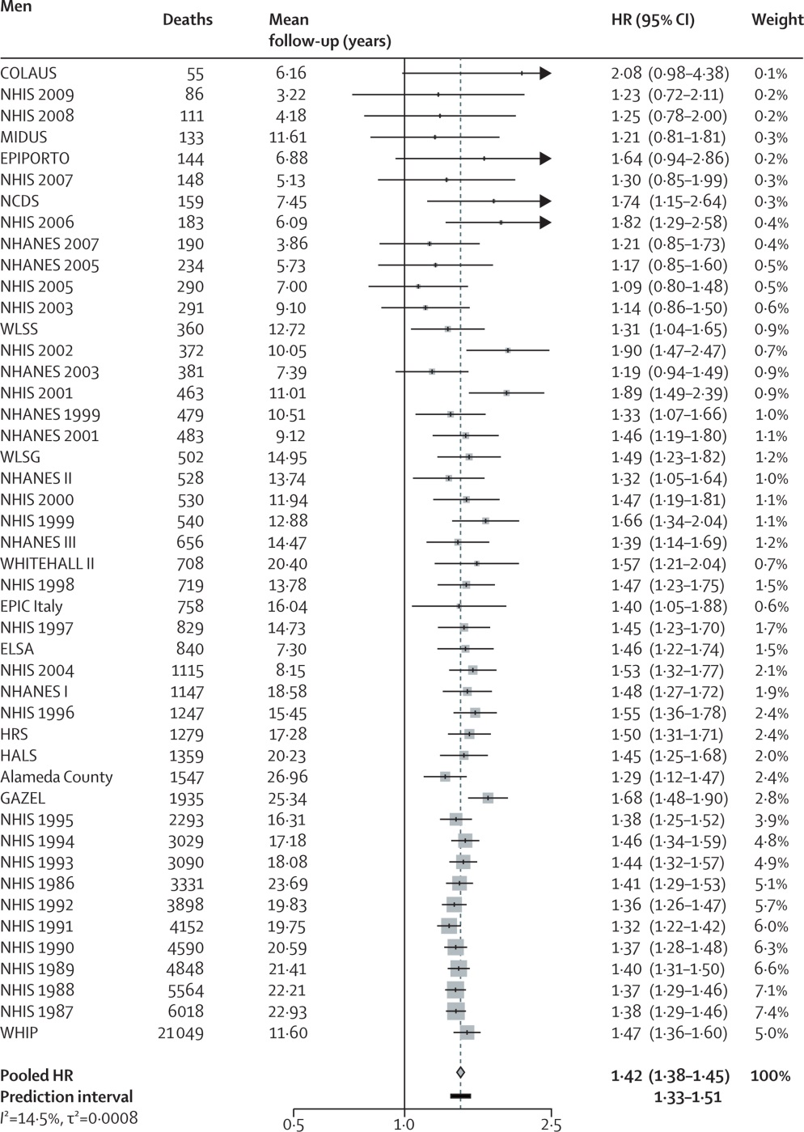
Fig 1: Forest plot of SES results for men
Meta analysis
For each study, get estimate of effect of SES on mortality
Combine estimates from the various studies:
Each study is weighted in relation to sample size
Gives a pooled HR
Use the bootstrap to get a prediction interval
Details: they used a “random effects” model, and calculated measures of heterogeneity across studies

Slide 6
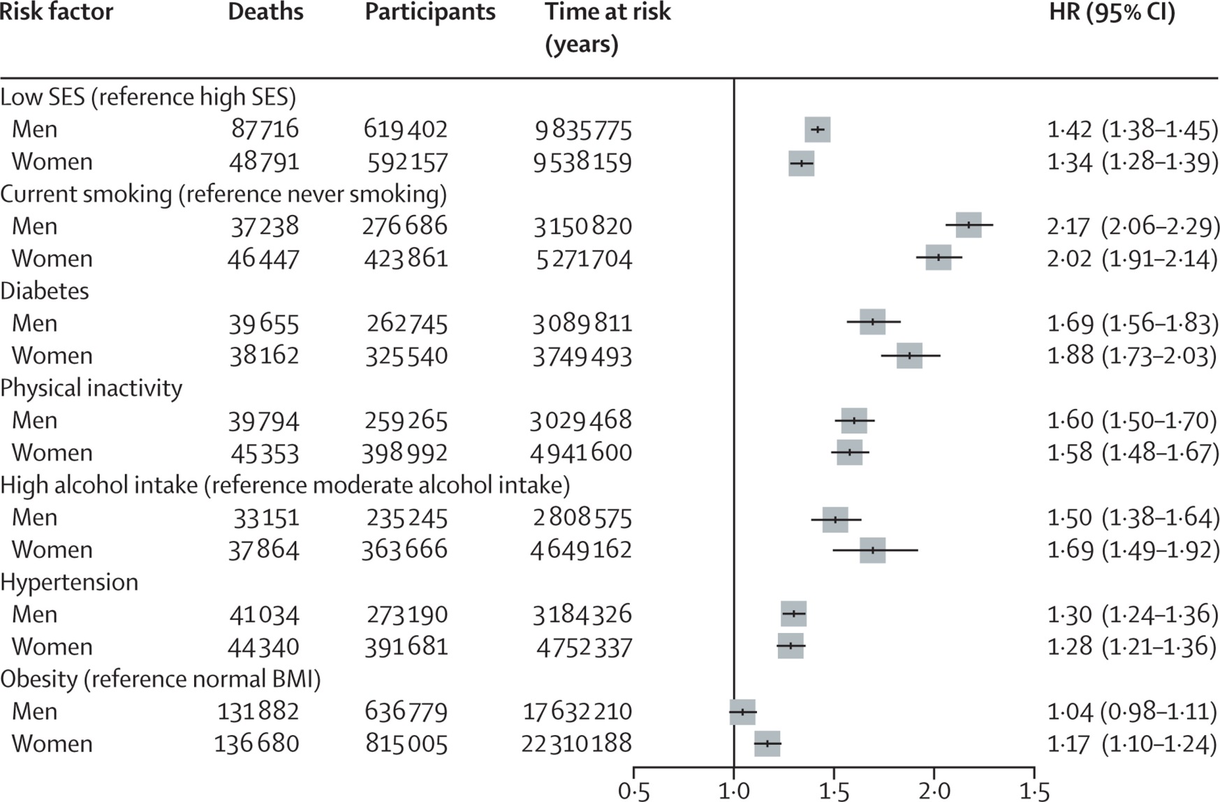
Comparing risk factors

